Slide 1
WIREFRAME DOCUMENT
AMAZON SALES DATA ANALYSIS
A.NOORJAHAN

Slide 2
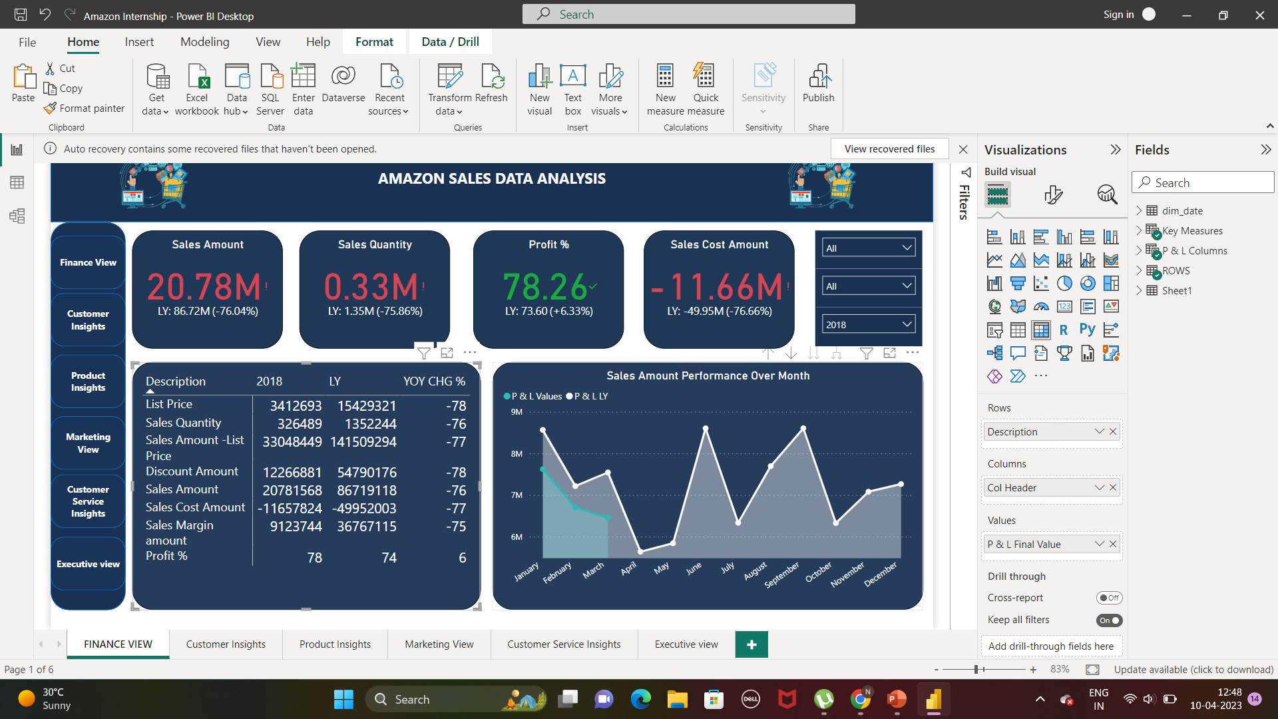
1.Which year gives the least profit? And why?
2018, because the product have sold for just 3 months in a year.

Slide 3
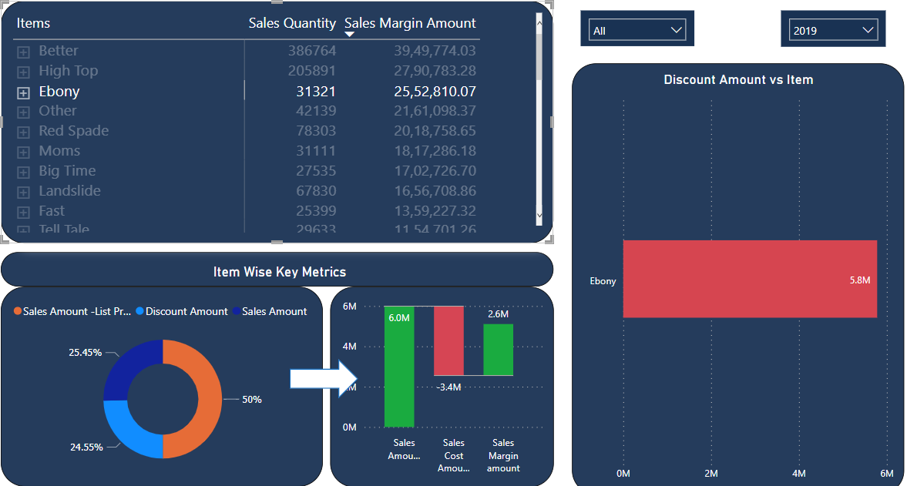
2.Which Product is getting more discount and not yielding that much High Sales Quantity?
Ebony, is getting 5.8M, but jus 30k products are sold and sales amount is by 6.0M that too,2.4M is the sales margin amount.

Slide 4
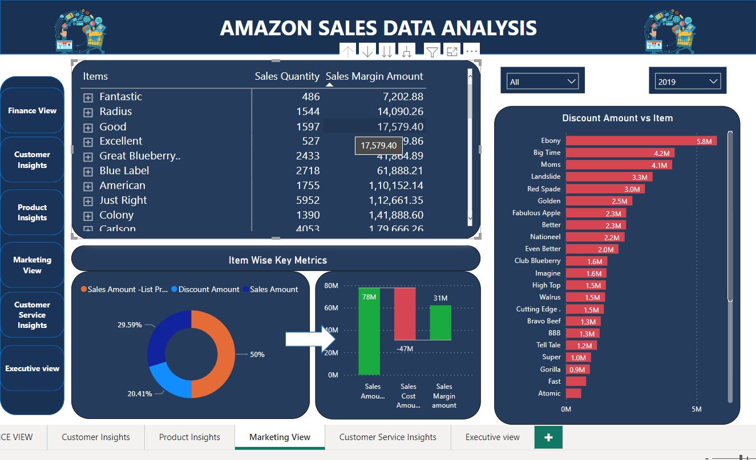
3.Does the discount amount is sole cause for low margin amount?
No, mostly margin amount is decided by the cost amount, as here in fantastic product it is least discount percentage, but it also the least product sold

Slide 5
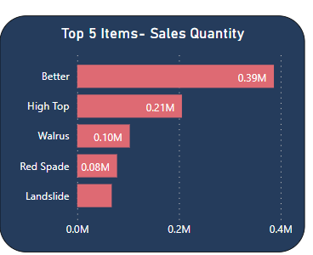
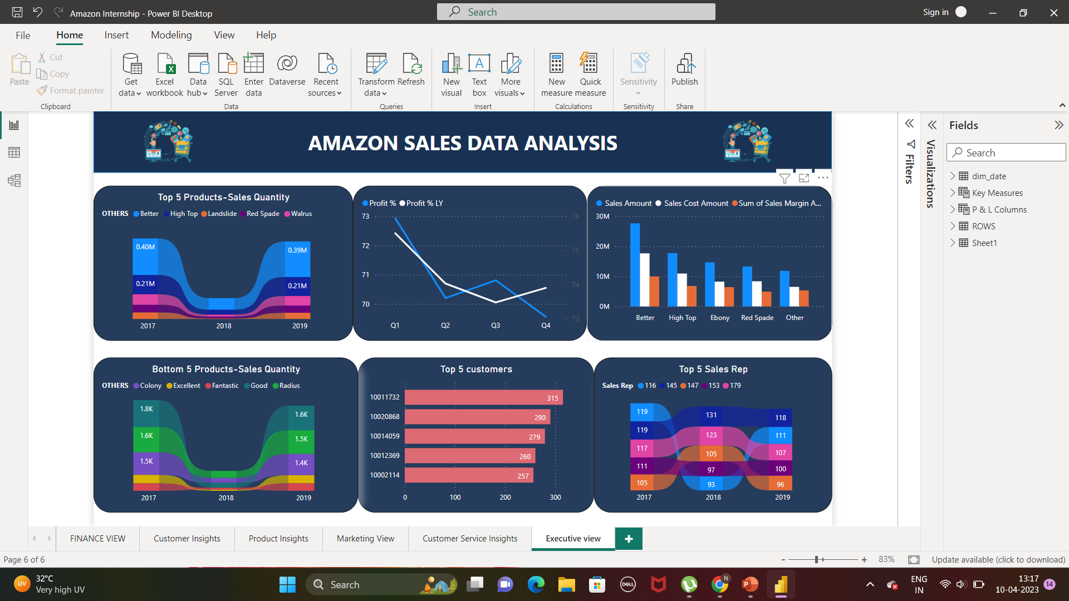
4.What is the top 5 product by sales quantity? what is the Top 5 product-Sales Cost Amount. Is any relationship between this?
Yes, because Better, High Top, Red Spade is most sales cost amount because of increased quantity in making it.
But the problem is with Ebony, which is among the top 3 sales cost amount

Slide 6


5. How many products are delivered on-time and it is mostly done by which Sales Rep?
Sales Rep 181 is delivering more products ON-TIME

Slide 7
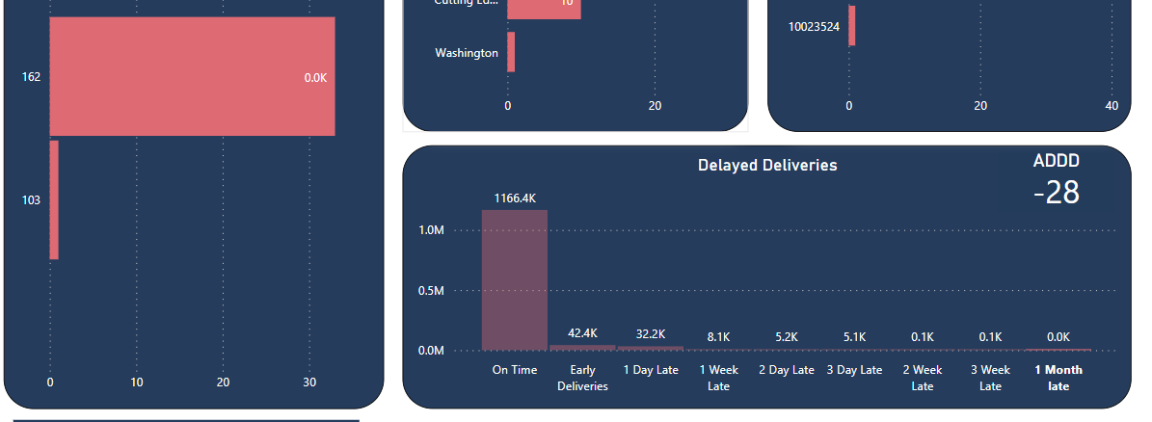

6. How many products are delivered late and by mostly done by which Sales Rep
Sales Rep 162 is more product by 1 month and 3 week late.
7.What is the average days of delayed delivery?
On an Average it is two days delivered late

Slide 8
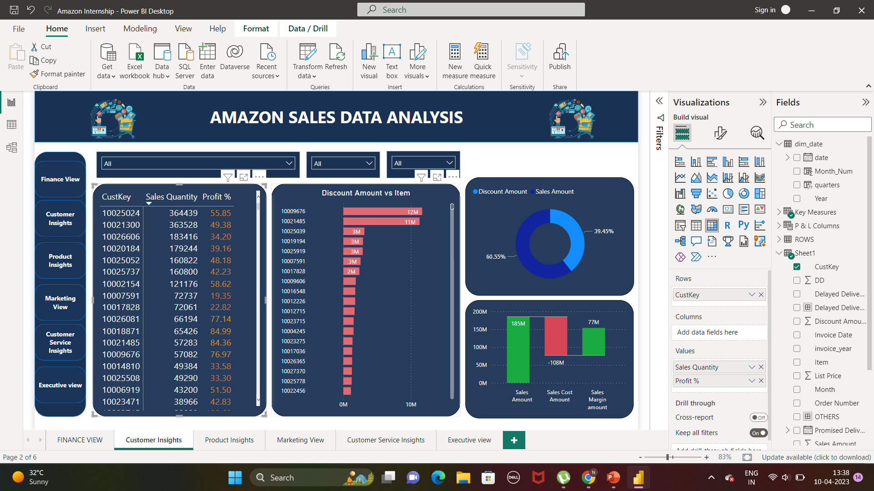
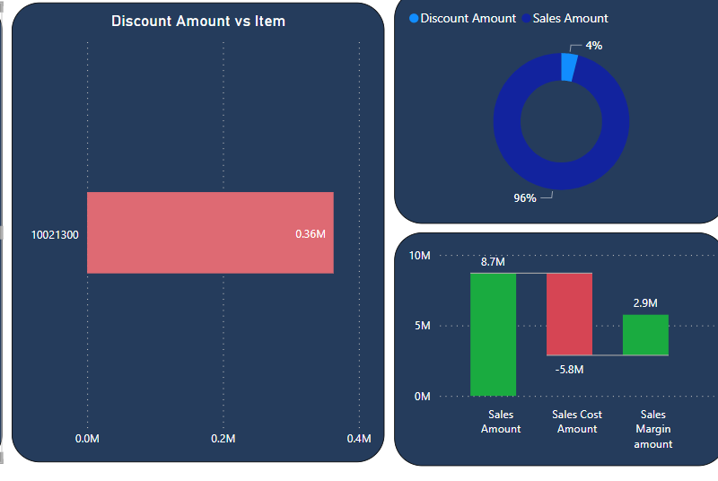

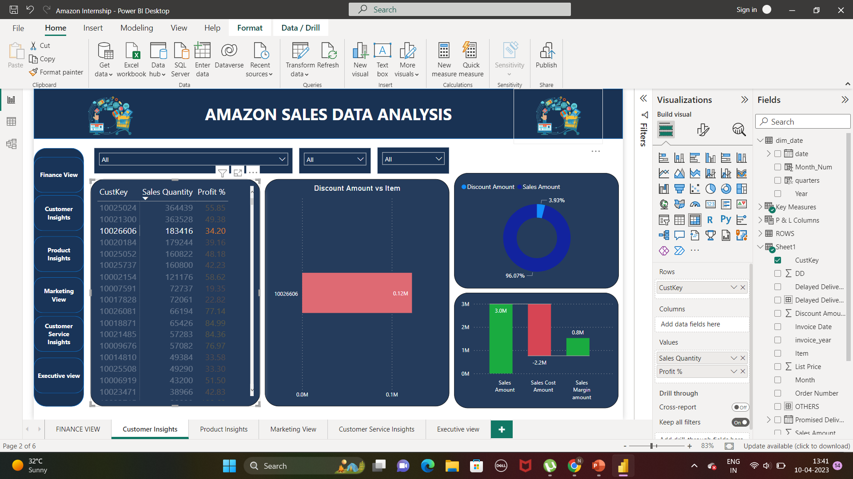
8.Are customer with high Sales Quantity is getting high discount?
Here, we can see that top 3 customer not getting high discount when compared with sales amount

Slide 9
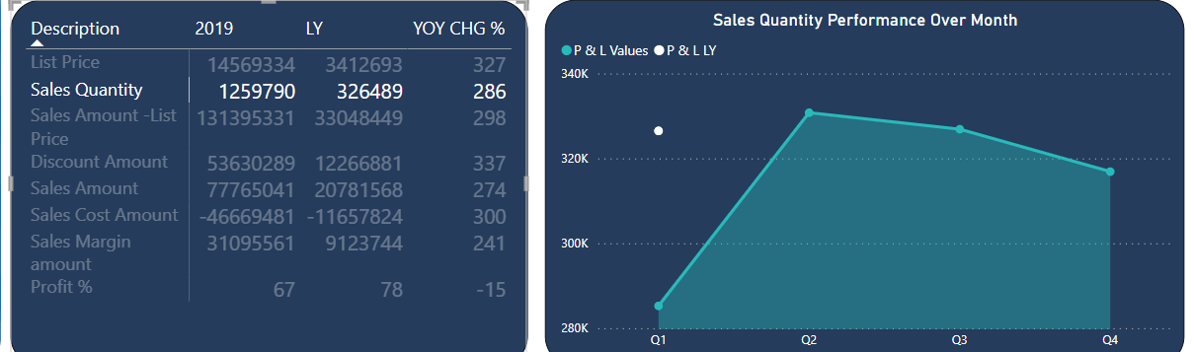
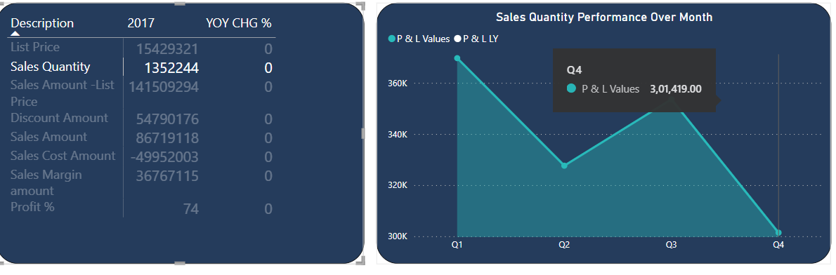
9. Which quarter is giving more sales in these three years
2019
Overall Q3 is best selling quarter
2017

Slide 10
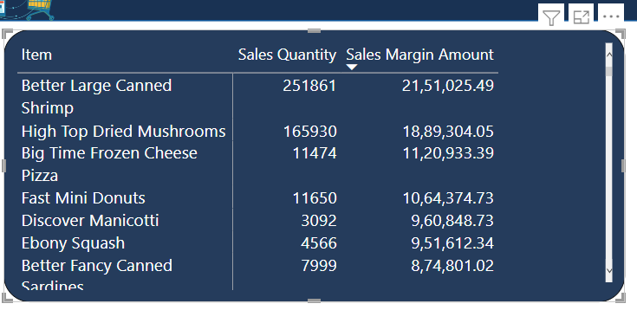
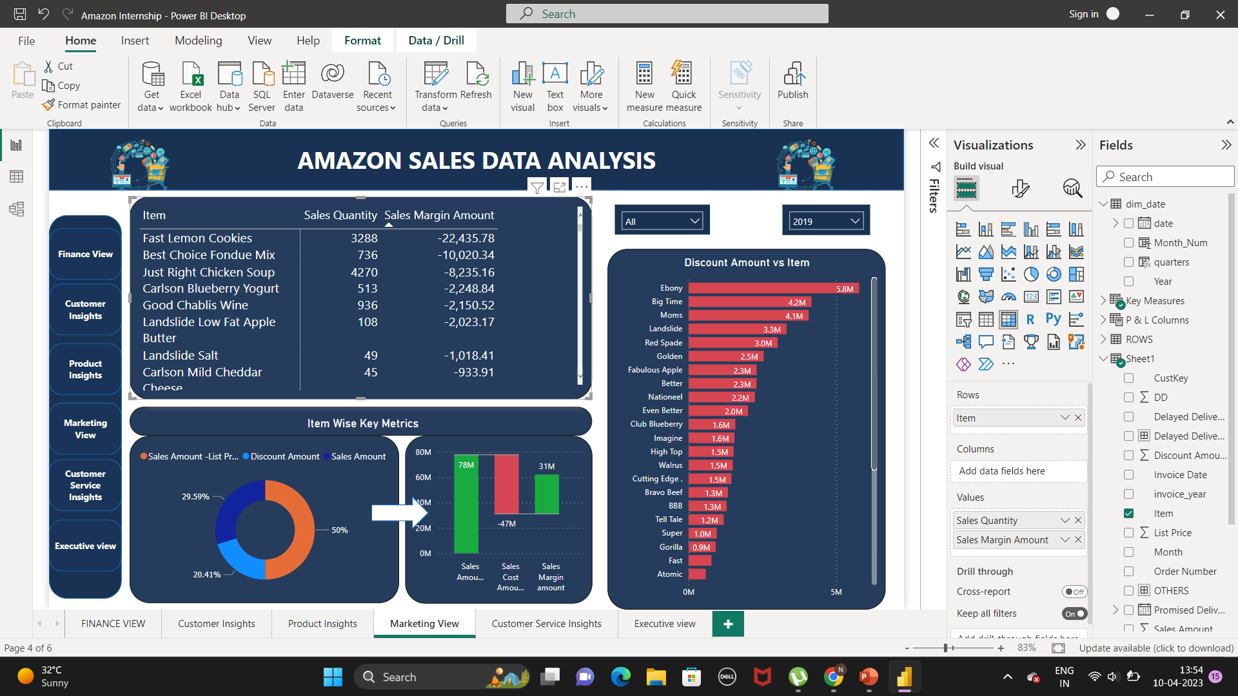
Top 5 Product by sales margin amount
Bottom 5 Product by sales margin amount

